Slide 1






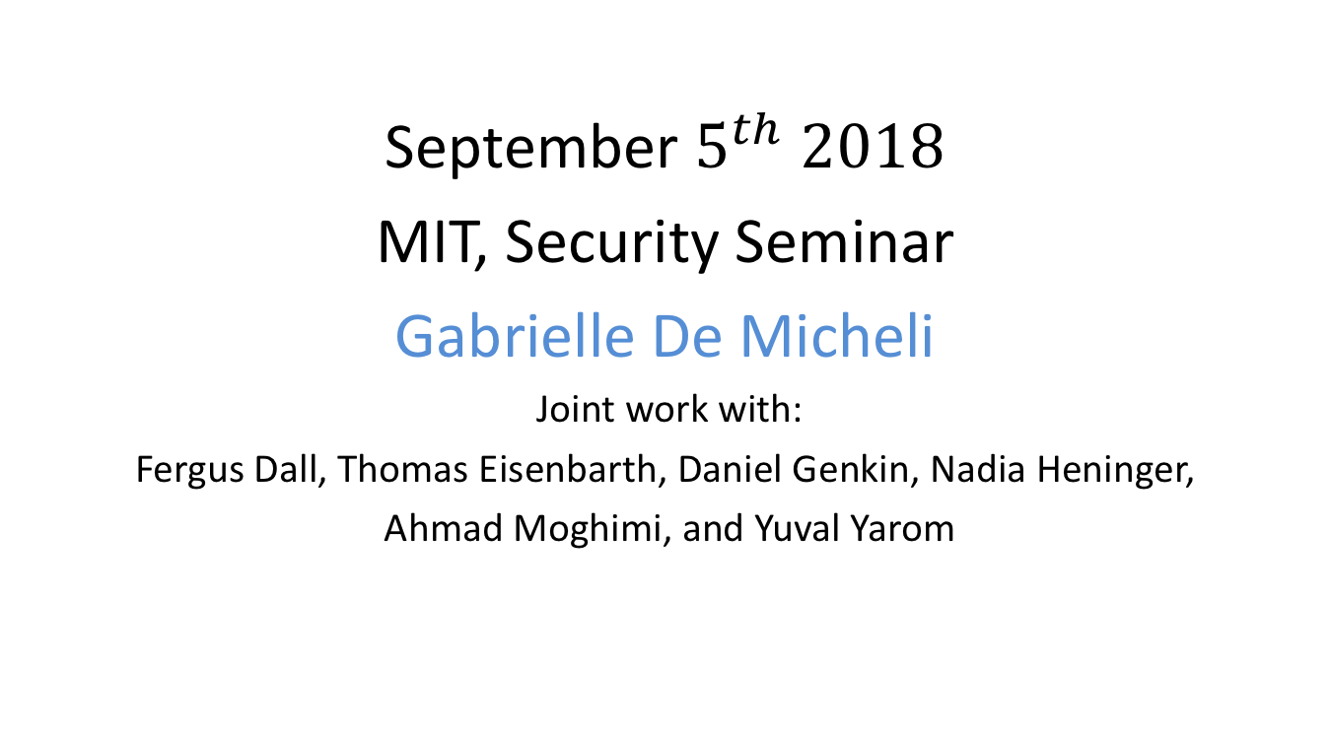
CacheQuote: Efficiently Recovering Long-term Secrets of SGX EPID via Cache Attacks
September $5^{th} 2018$
MIT, Security Seminar
Gabrielle De Micheli
Joint work with:
Fergus Dall, Thomas Eisenbarth, Daniel Genkin, Nadia Heninger,
Ahmad Moghimi, and Yuval Yarom

Slide 2



Intel Software Guard Extensions
Mail
Data …
Set of instructions aiming to guarantee confidentiality and integrity of applications that run inside untrusted environments.
Protects enclaves of code and data
Notes:
security technology since 2015
set of extensions to the Intel x86 architecture.
allows users to perform secure computations on platforms that run untrusted software.

Slide 3
Enclaves
A
Enclave
code
data
Enclaves are isolated from the software running on the computer
SGX controls the entry to and exit from enclaves
Application
OS
Notes:
isolated from other software.
SGX controls access to the enclaves in a way that even the operating system cannot read the data which is contained in the enclave.

Slide 4





Remote attestation: EPID
quote
Intel
SGX
Trust me !
Shared secret
EPID key
Client
Verification by
Intel
Intel Attestation
Service
Trust is based on the EPID key!
Why need IAS ? Revocation !
All quotes are encrypted by SGX.

Slide 5
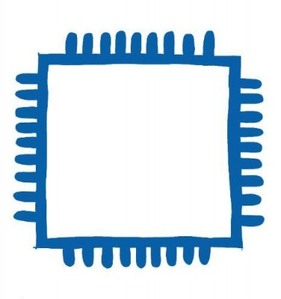

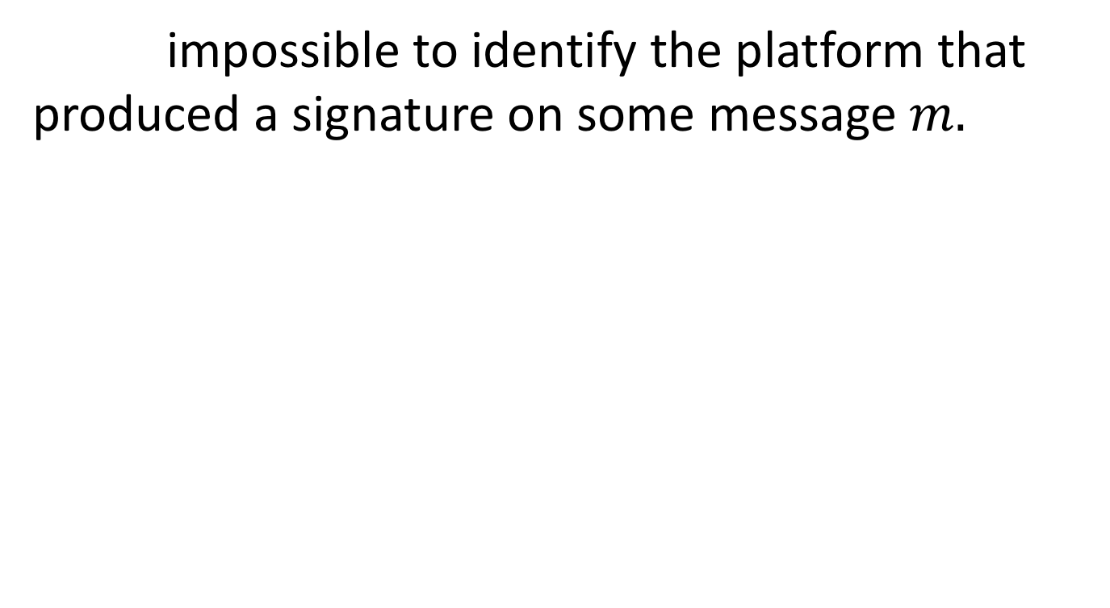
Unlinkability
impossible to identify the platform that produced a signature on some message $m.$
Notes:
The red processor can generate a quote, after the quote is send to the network, there is no way to distinguish this quote from other quotes.

Slide 6

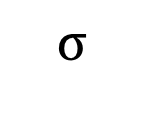
Unforgeability
impossible for an attacker to forge a valid signature on some previously-unsigned message, without knowing a non-revoked secret key.
m
$$σ$$
NO!

Slide 7
Our results
First cache attacks on Intel’s EPID protocol implemented inside SGX.
Recover part of the enclave’s long term secret key.
Malicious attestation server (Intel) can break the unlinkability guarantees of SGX’s remote attestation protocol.

Slide 8


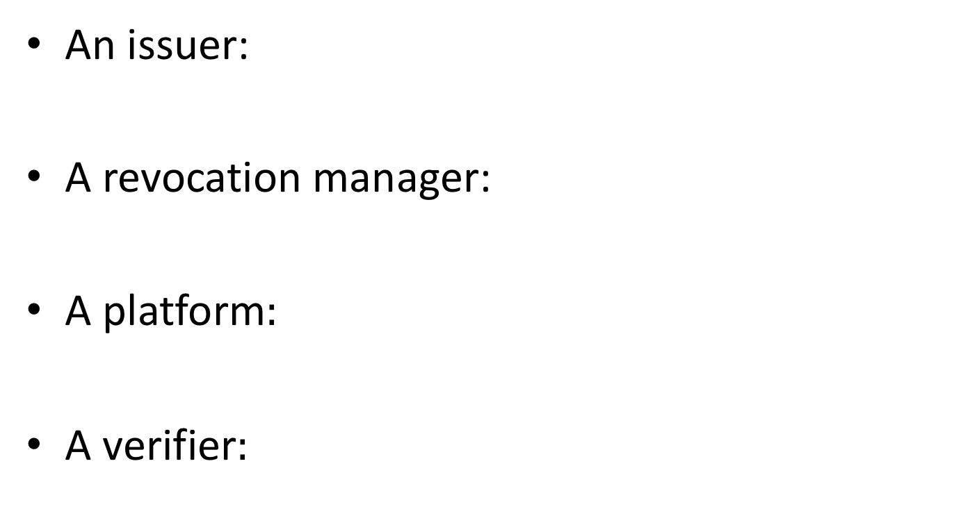
EPID: setup
An issuer:
A revocation manager:
A platform$:$
A verifier$:$

Slide 9
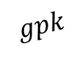
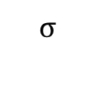
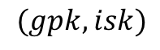
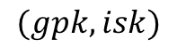
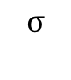
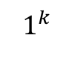
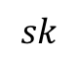
EPID: algorithms
$$1^{k}$$
Setup
Join
Sign
Verify
$$(gpk, isk)$$
issuer
$$(gpk, isk)$$
$$sk$$
$$gpk$$
platform
platform
m, sk
$$σ$$
$$σ$$
Verifier
platform
Client
Yes/No
Verifier
Notes:
Revocation manager revoke platforms whose keys and signature are compromised.

Slide 10
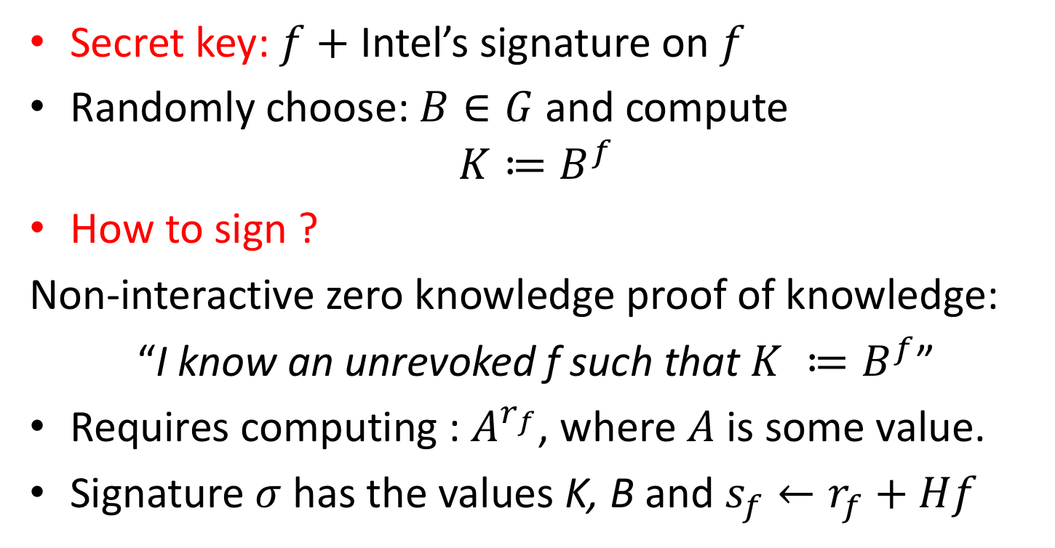
The signing algorithm
Secret key: $f+$Intel’s signature on $f$
Randomly choose: $B∈G$ and compute
$$K≔B^{f}$$
How to sign ?
Non-interactive zero knowledge proof of knowledge:
“I know an unrevoked f such that $K ≔B^{f}$”
Requires computing : $A^{r_{f}}$, where $A$ is some value.
Signature $σ$ has the values K, B and $s_{f}←r_{f}+Hf$

Slide 11
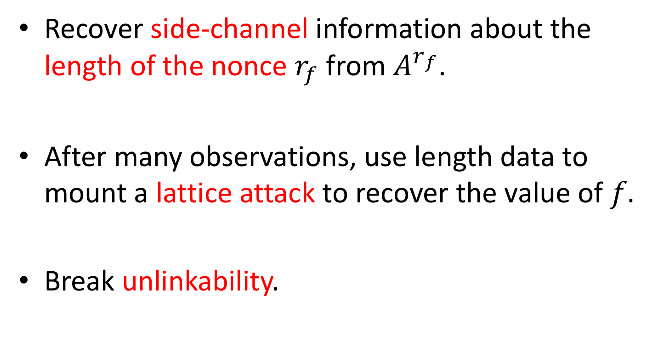
Attack idea
Recover side-channel information about the length of the nonce $r_{f}$ from $A^{r_{f}}$.
After many observations, use length data to mount a lattice attack to recover the value of $f.$
Break unlinkability.

Slide 12
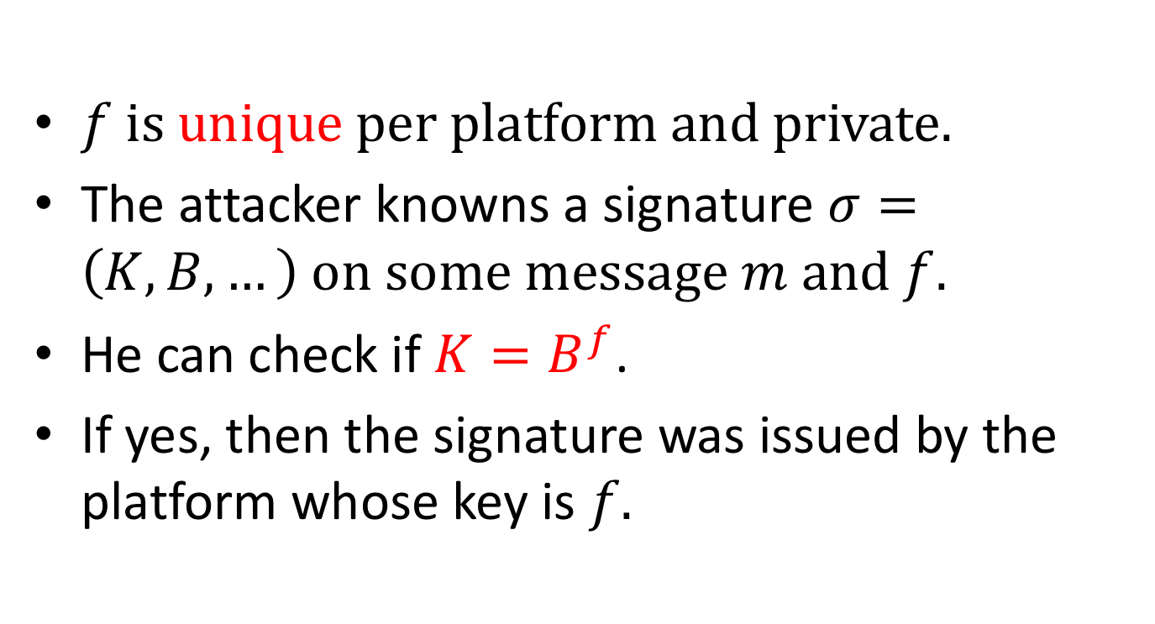
How unlinkability is broken?
$f is unique per platform and private.$
The attacker knowns a signature $σ=\left(K, B, …\right) on some message m and f.$
He can check if $K=B^{f}$.
If yes, then the signature was issued by the platform whose key is $f.$

Slide 13
Side-channel attacks
Attacks based on information obtained from leakage between software and hardware.
Timing side-channel attacks: exploit timing variation in execution time of cryptographic algorithms.
Example: execution time of square and multiply algorithm used in modular exponentiation depends linearly on the number of non-zero bits in the key.
Notes:
(based on the type of information the attacker learns about a victim cipher.)

Slide 14
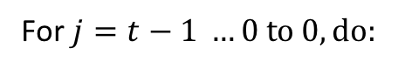
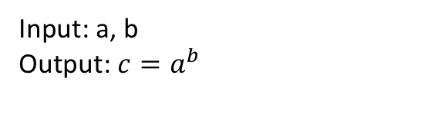
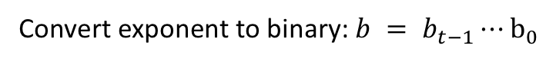
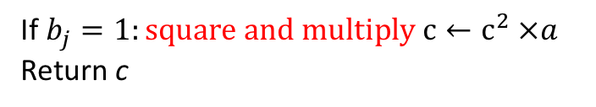
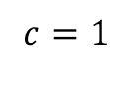
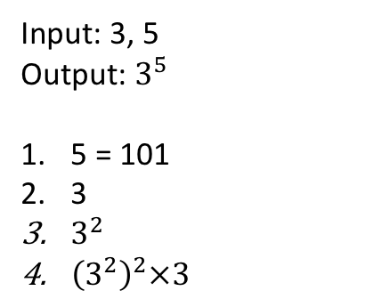
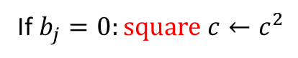
Square and multiply
Goal: fast computation of large positive integer powers of a number
Algorithm
Example
Input: a, b
Output: ${c=a}^{b}$
Input: 3, 5
Output: $3^{5}$
5 = 101
3
$3^{2}$
${\left(3^{2}\right)}^{2}×3$
Convert exponent to binary: $b = b_{t−1}⋯b_{0}$
$$c=1$$
For $j=t−1 …0 to 0, do:$
If $b_{j}=0:square c←c^{2}$
If $b_{j}=1:square and multiply c←c^{2} ×a$
Return c
We did 3 computations instead of 5!
1024: in binary: 10000000000 10 calculations
Time of execution depends on number of multiplication, which depends on the number of 1’s.

Slide 15
Cache attacks
Memory accesses are not always performed in constant time!
Cache attacks: analysis of the cache behavior.
Attacks: Prime and Probe [Per05, OST06]

Slide 16
CPU vs. Memory
Cache are used to bridge the gap
Divides memory into lines
Stores recently used lines
In a cache hit, data is retrieved from the cache
In a cache miss, data is retrieved from memory and inserted to the cache
Processor
Cache
Memory
Notes:
Consequence gap : processor reads from memory it needs to wait -> fast processor that mostly waits for the memory.
bridge this gap, processor designers small bank of memory called "cache" between main memory and the processor: small, closer to the execution core, more expensive technologies.
Cache divides memory into units called lines. When the processor accesses memory the cache brings the line that contains the requested data from memory and provide the data to the processor. At the same time, it also stores a copy of the data.

Slide 17
Set Associative Caches
Memory lines map to cache sets. Multiple lines map to the same set.
Sets consist of ways. A memory line can be stored in any of the ways of the set it maps to.
When a cache miss occurs, one of the lines in the set is evicted.
Sets
Ways
Memory
Notes:
Modern caches are set associative : the cache is divided into multiple sets, each consisting of multiple ways.
Each memory line is mapped to a specific cache set, and can only be stored in that cache set.
When the processor accesses a memory line, it is brought to the cache and stored in one of the ways in the cache set.
all of the ways of the set are full, the cache has to evict one of the entries there and store the new line.

Slide 18


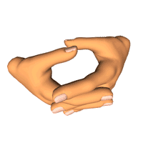
The Prime+Probe Attack [Per05, OST06]
Allocate a cache-sized memory buffer
Prime: fills the cache with the contents of the buffer
Probe: measure the time to access each cache set
Slow access indicates victim access to the set
Memory

Slide 19
Prime+Probe attack examples
RSA (OpenSSL 0.9.7c), Percival 2005
AES (OpenSSL 0.9.8), Osvik, Shamir, and Tromer. 2005 Tromer, Osvik, and Shamir. 2010
DSA (OpenSSL 0.9.8d) Onur Acıic¸mez, Brumley, and Grabher. 2010
ECDSA (OpenSSL 0.9.8k) Brumley and Hakala. 2009
ElGamal (GnuPG v.2.0.19,libgcrypt v.1.5.0) Zhang, Juels, Reiter, and Ristenpart. 2012

Slide 20
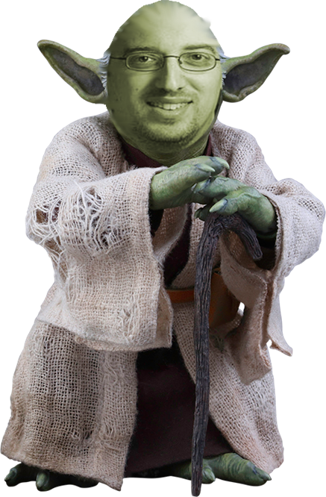
Countermeasures
Constant-time techniques:
remove conditional execution (two conditions can have different execution time)
no secret dependent memory access …

Slide 21
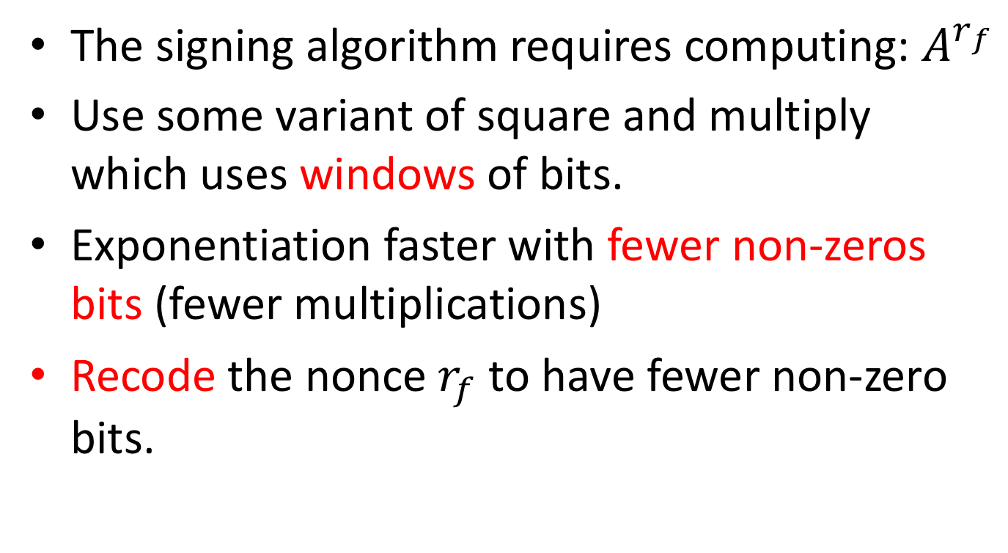
In our attack
The signing algorithm requires computing: $A^{r_{f}}$
Use some variant of square and multiply which uses windows of bits.
Exponentiation faster with fewer non-zeros bits (fewer multiplications)
Recode the nonce $r_{f}$ to have fewer non-zero bits.

Slide 22
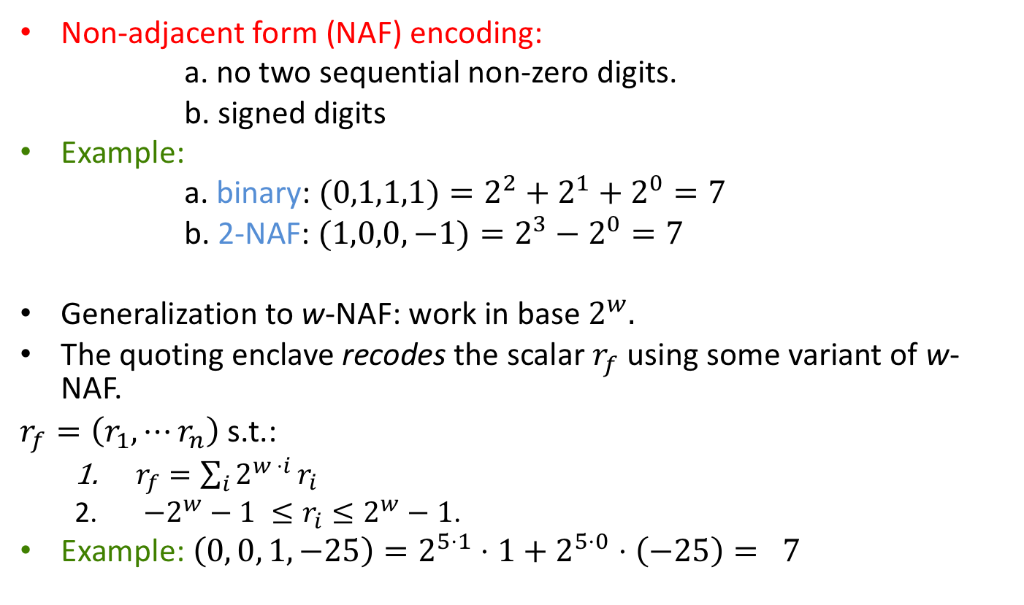
Recoding the nonces
Non-adjacent form (NAF) encoding:
a. no two sequential non-zero digits.
b. signed digits
Example:
a. binary: $(0,1,1,1)=2^{2}+2^{1}+2^{0}=7$
b. 2-NAF: $(1,0,0,−1)=2^{3}−2^{0}=7$
Generalization to w-NAF: work in base $2^{w}.$
The quoting enclave recodes the scalar $r_{f}$ using some variant of w-NAF.
$r_{f}=\left(r_{1},⋯r_{n}\right)$ s.t.:
$r_{f}=\sum_{i}{2^{w ⋅i }r_{i}}$
$−2^{w}−1 ≤r_{i}≤2^{w}−1$.
Example: $\left(0, 0, 1, −25\right)=2^{5⋅1}⋅1+2^{5⋅0}⋅\left(−25\right)= 7$

Slide 23
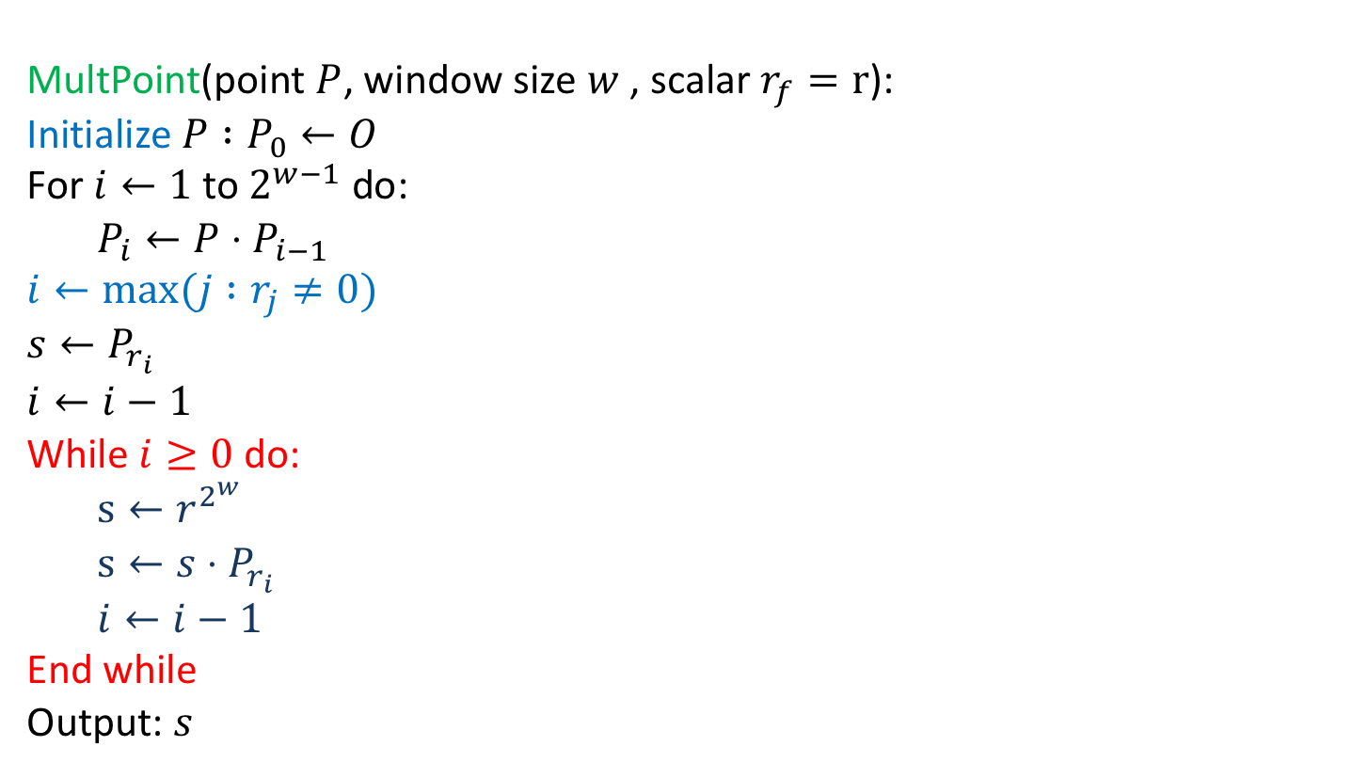
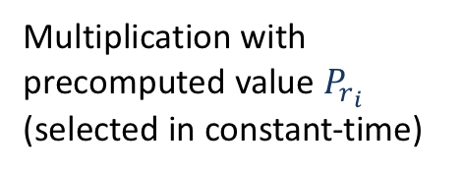
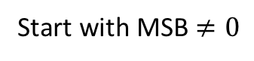
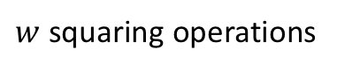
Scalar multiplication algorithm
MultPoint(point $P$, window size $w$, scalar $r_{f}=r$):
Initialize $P :P_{0}←O$
For $i←1$ to $2^{w−1}$ do:
$P_{i}←P⋅P_{i−1}$
$$i←max⁡(j :r_{j}≠0)$$
$$s←P_{r_{i}}$$
$$i←i−1$$
While $i≥0$ do:
$s←r^{2^{w}}$
$s←s⋅P_{r_{i}}$
$i←i−1$
End while
Output: $s$
Start with MSB $≠0$
$w$ squaring operations
Main loop
Multiplication with precomputed value $P_{r_{i}}$ (selected in constant-time)
Scalar of length 256 bits recoded scalar of length 52 51 loop iterations.
Bits 256 and 255 are 0 recoded scalar of length 51 50 loop iterations.

Slide 24
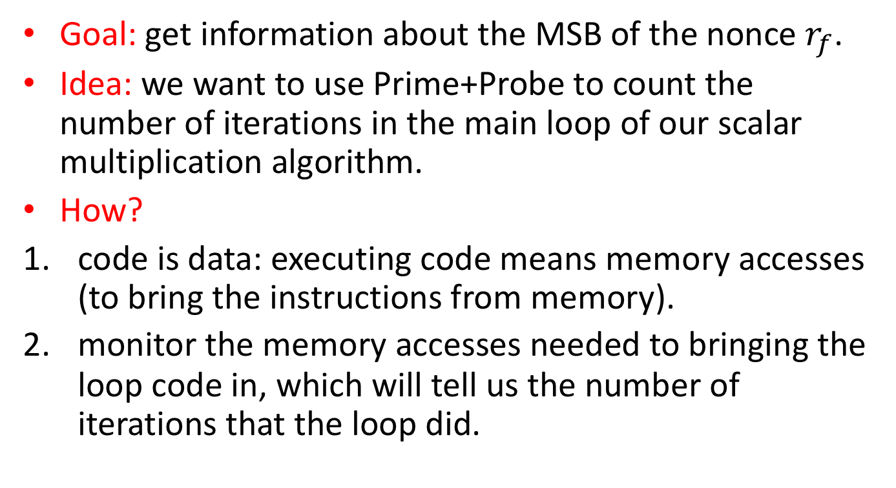
Going back to the attack
Goal: get information about the MSB of the nonce $r_{f}$.
Idea: we want to use Prime+Probe to count the number of iterations in the main loop of our scalar multiplication algorithm.
How?
code is data: executing code means memory accesses (to bring the instructions from memory).
monitor the memory accesses needed to bringing the loop code in, which will tell us the number of iterations that the loop did.

Slide 25
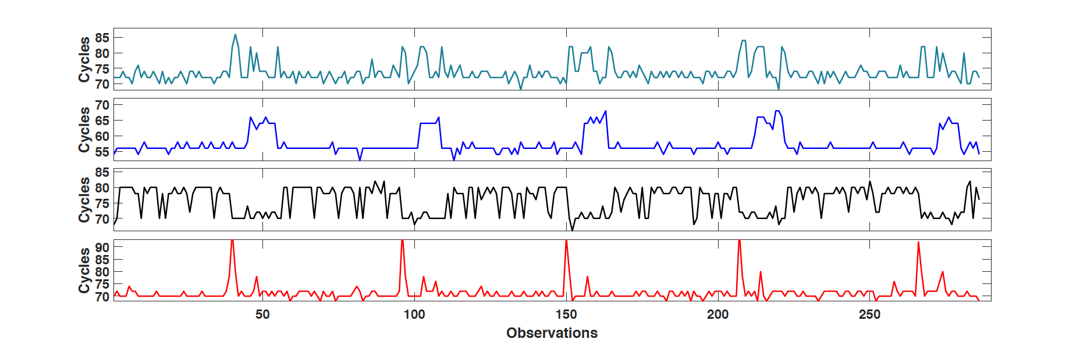
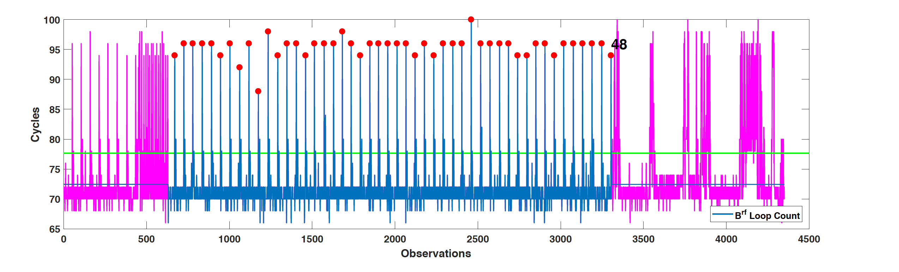
Counting loops
Monitor cache access patterns during the computation of the main
loop.
One period corresponds to one loop iteration.
Number of periods gives us information on the number of iterations.

Slide 26
Counting loop iterations automatically
Matlab signal processing toolbox.
Use several cache sets: the signal pattern is unique for each cache sets).
Use five different loop counters that use information from different cache sets to count number of loops on each signature.

Slide 27
Handling noise
Common sources of error:
failing to accurately detect the beginning and the end of the multiplier window.
under-counting short peaks
over-counting occasional noises that introduce unexpected peaks or pattern.
if four of the five loop counters agree on the number of loop iterations, the loop counting would be error free.

Slide 28
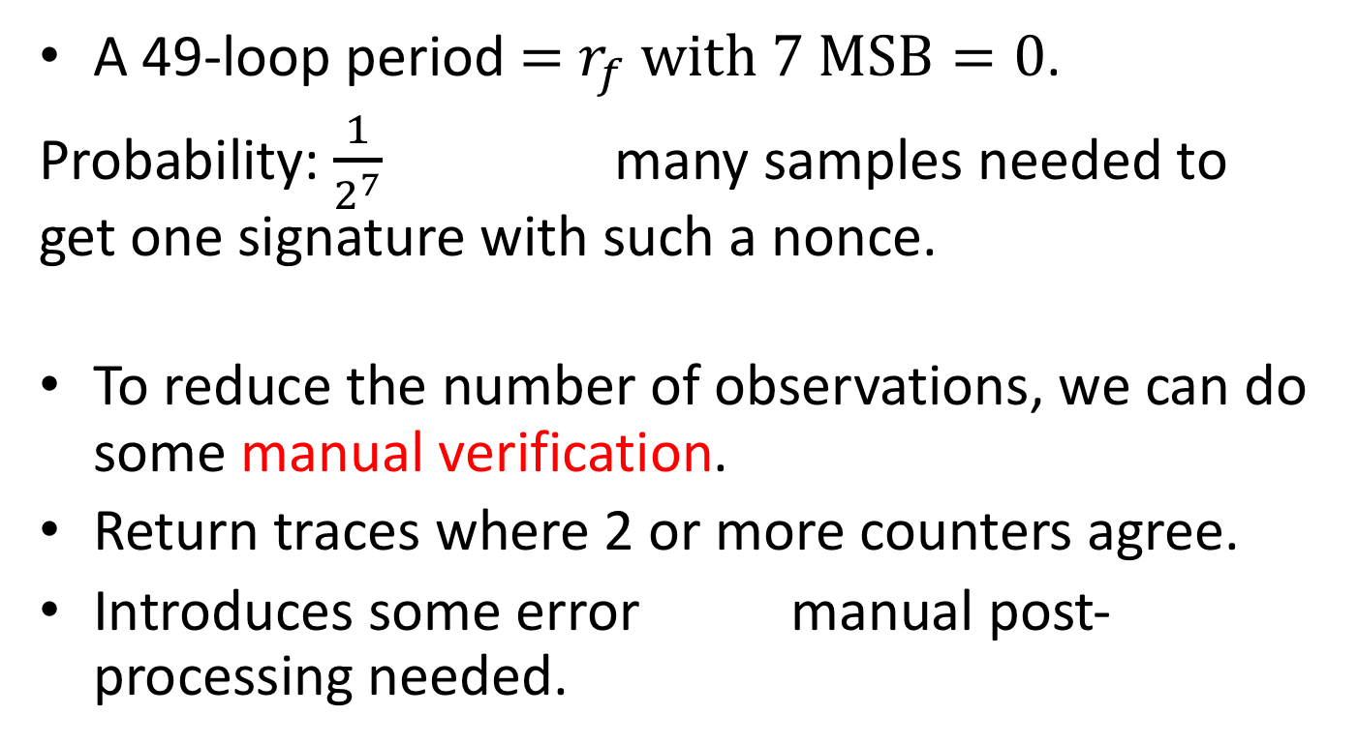
Analyzing the data
A 49-loop period $=$ $r_{f} with 7 MSB=0$.
Probability: $\frac{1}{2^{7}}$ many samples needed to get one signature with such a nonce.
To reduce the number of observations, we can do some manual verification.
Return traces where 2 or more counters agree.
Introduces some error manual post-processing needed.

Slide 29


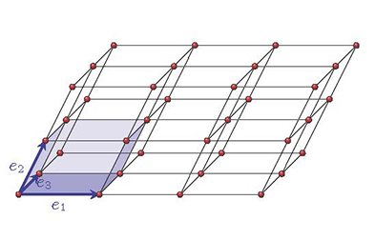
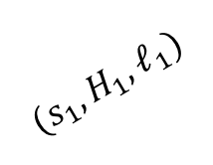
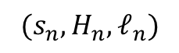
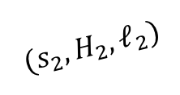

The road ahead
$$(s_{1},H_{1},ℓ_{1})$$
$$(s_{2},H_{2},ℓ_{2})$$
$$f$$
…
$$(s_{n},H_{n},ℓ_{n})$$

Slide 30
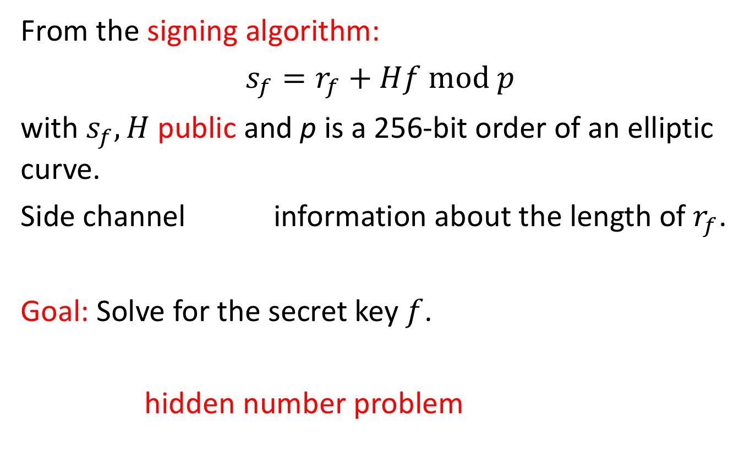
A lattice attack
From the signing algorithm:
$s_{f}=r_{f}+Hf mod p$
with $s_{f}, H$ public and p is a 256-bit order of an elliptic curve.
Side channel information about the length of $r_{f}$.
Goal: Solve for the secret key $f$.
hidden number problem

Slide 31
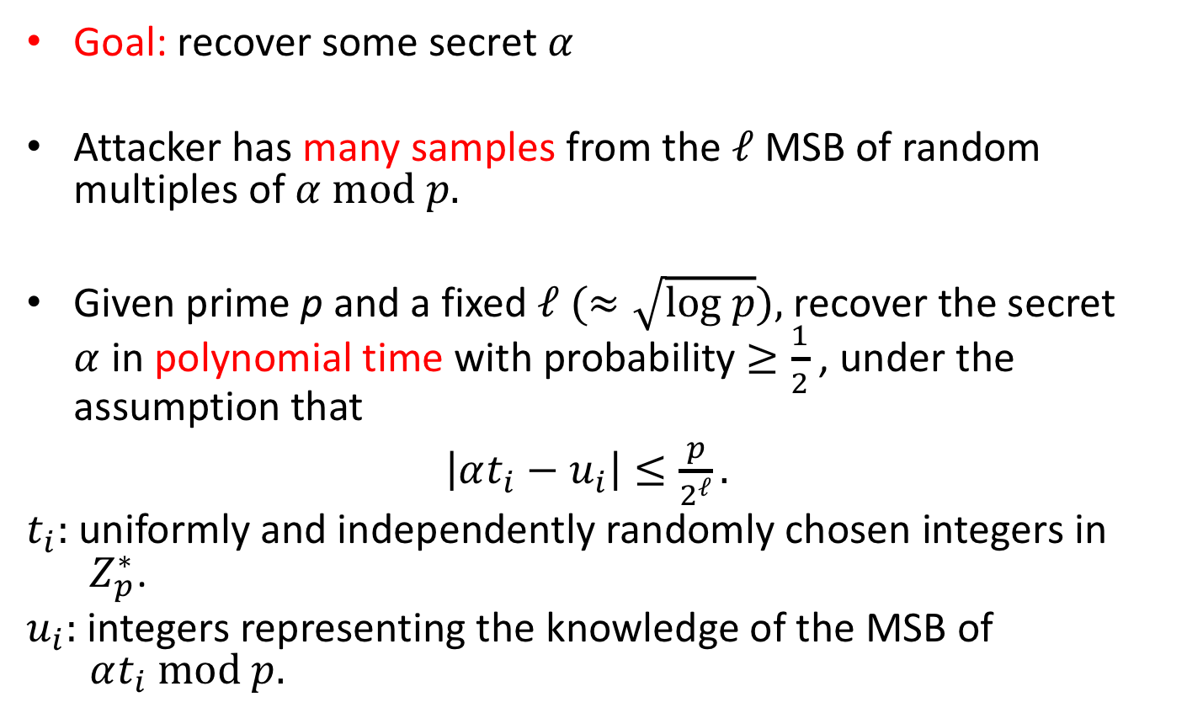
The hidden number problem (HNP) [BV96]
Goal: recover some secret $α$
Attacker has many samples from the $ℓ$ MSB of random multiples of $α mod p.$
Given prime p and a fixed $ℓ (≈\sqrt{log p}),$ recover the secret $α$ in polynomial time with probability $≥\frac{1}{2}$, under the assumption that
$\left|αt_{i}−u_{i}\right|≤\frac{p}{2^{ℓ}}.$
$t_{i}:$uniformly and independently randomly chosen integers in $Z_{p}^{∗}$.
$u_{i}:$ integers representing the knowledge of the MSB of $αt_{i} mod p.$

Slide 32
Applications of the HNP
Boneh and Venkatesan: prove the existence of hardcore bits for the Diffie-Hellman key exchange [BV96].
Nguyen and Shparlinski: attack DSA and ECDSA signing algorithms [NS02, NS03].
Many attacks on implementations of the (EC)DSA algorithm.
Notes:
BV96: computing the most significant bits of the secret key in a Diffie-Hellman key-exchange protocol from the public keys of the participants is as hard as computing the secret key itself

Slide 33
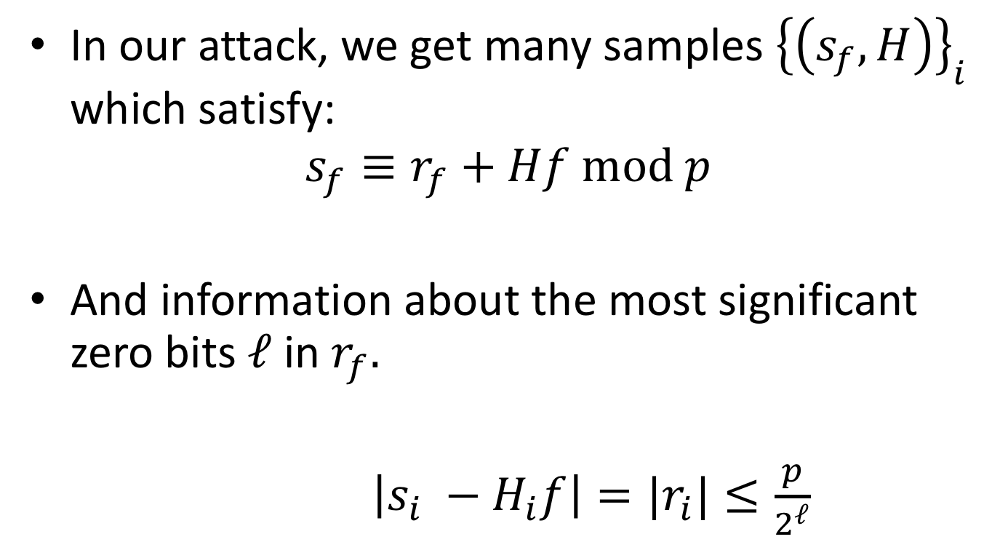
Converting our problem to HNP
In our attack, we get many samples ${\left\{\left(s_{f}, H\right)\right\}}_{i}$ which satisfy:
$$s_{f}≡r_{f}+Hf mod p$$
And information about the most significant zero bits $ℓ$ in $r_{f}.$
$\left|s_{i} −H_{i}f\right|=|r_{i}|≤\frac{p}{2^{ℓ}}$

Slide 34
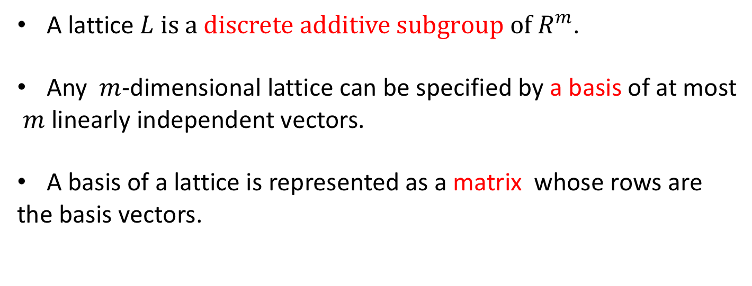
Lattices
A lattice $L is a discrete additive subgroup of R^{m}$.
Any $m$-dimensional lattice can be specified by a basis of at most
$m$ linearly independent vectors.
A basis of a lattice is represented as a matrix whose rows are
the basis vectors.

Slide 35
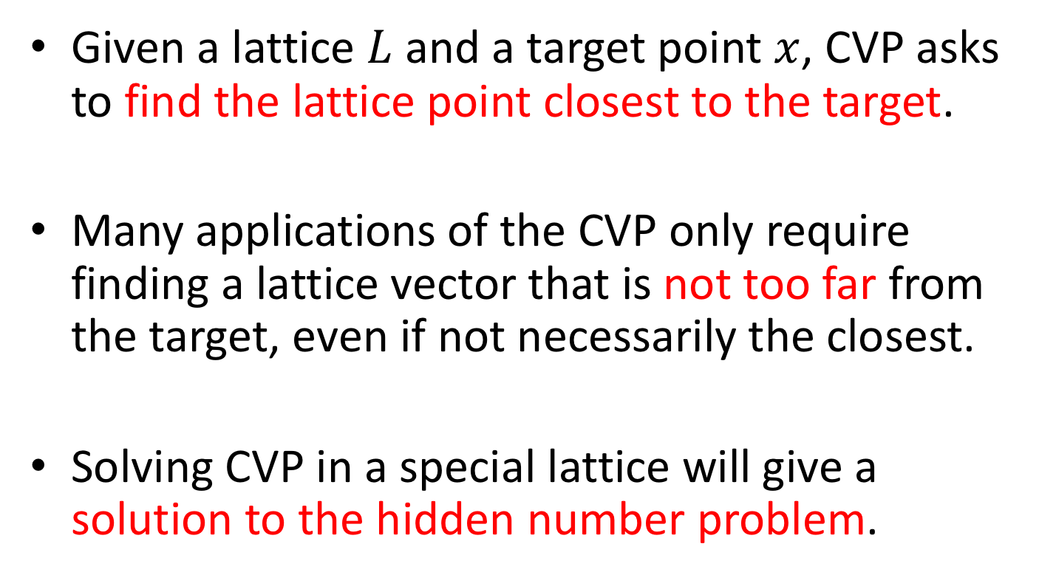
Closest Vector Problem (CVP)
Given a lattice $L$ and a target point $x$, CVP asks to find the lattice point closest to the target.
Many applications of the CVP only require finding a lattice vector that is not too far from the target, even if not necessarily the closest.
Solving CVP in a special lattice will give a solution to the hidden number problem.

Slide 36
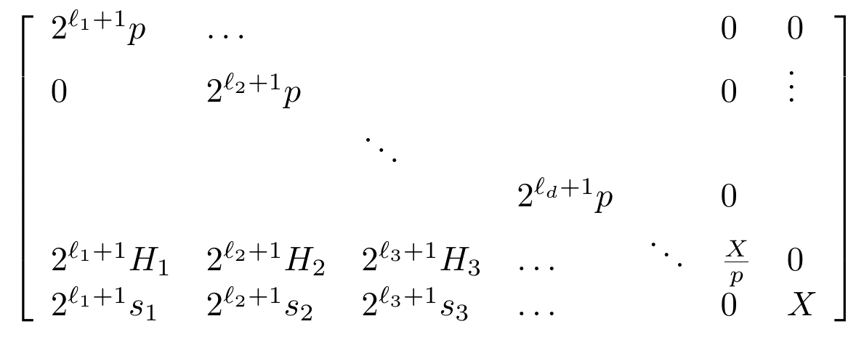
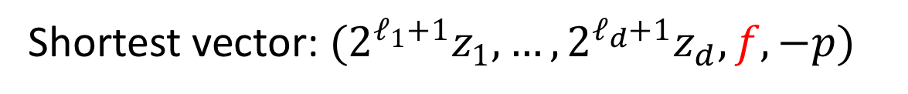
CVP embedding
Target vector for CVP
Shortest vector: $(2^{ℓ_{1}+1}z_{1}, …, 2^{ℓ_{d}+1}z_{d}, f, −p)$
Notes:
X is a bound on the r_i
shortest vector = zB for z = (z1, …, zm, f, -1)

Slide 37
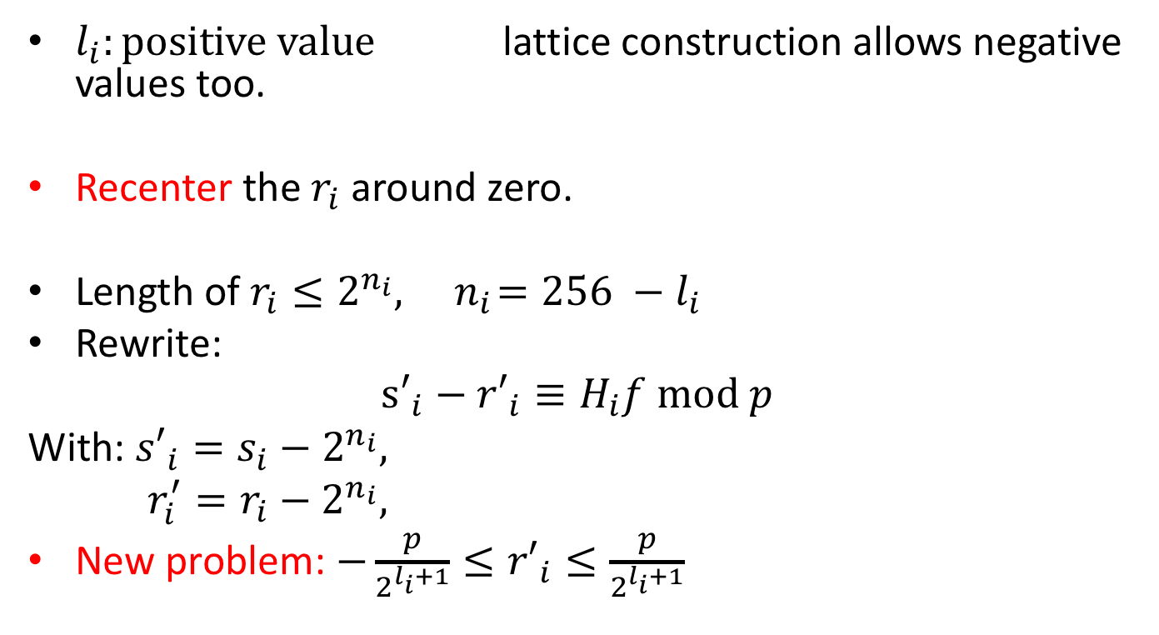
Recentering the nonces
$l_{i}:positive value$ lattice construction allows negative values too.
Recenter the $r_{i}$ around zero.
Length of $r_{i}≤2^{n_{i}}, { n}_{i}=256 −l_{i}$
Rewrite:
$${s′}_{i}−{r′}_{i}≡H_{i}f mod p$$
With: ${s′}_{i}=s_{i}−2^{n_{i}},$
$r_{i}^{′}=r_{i}−2^{n_{i}},$
New problem: $−\frac{p}{2^{l_{i}+1}}≤{r′}_{i}≤\frac{p}{2^{l_{i}+1}}$

Slide 38
Effect of recentering the nonces
Recentering the nonces has a noticeable impact on the number of
samples required for key recovery.

Slide 39
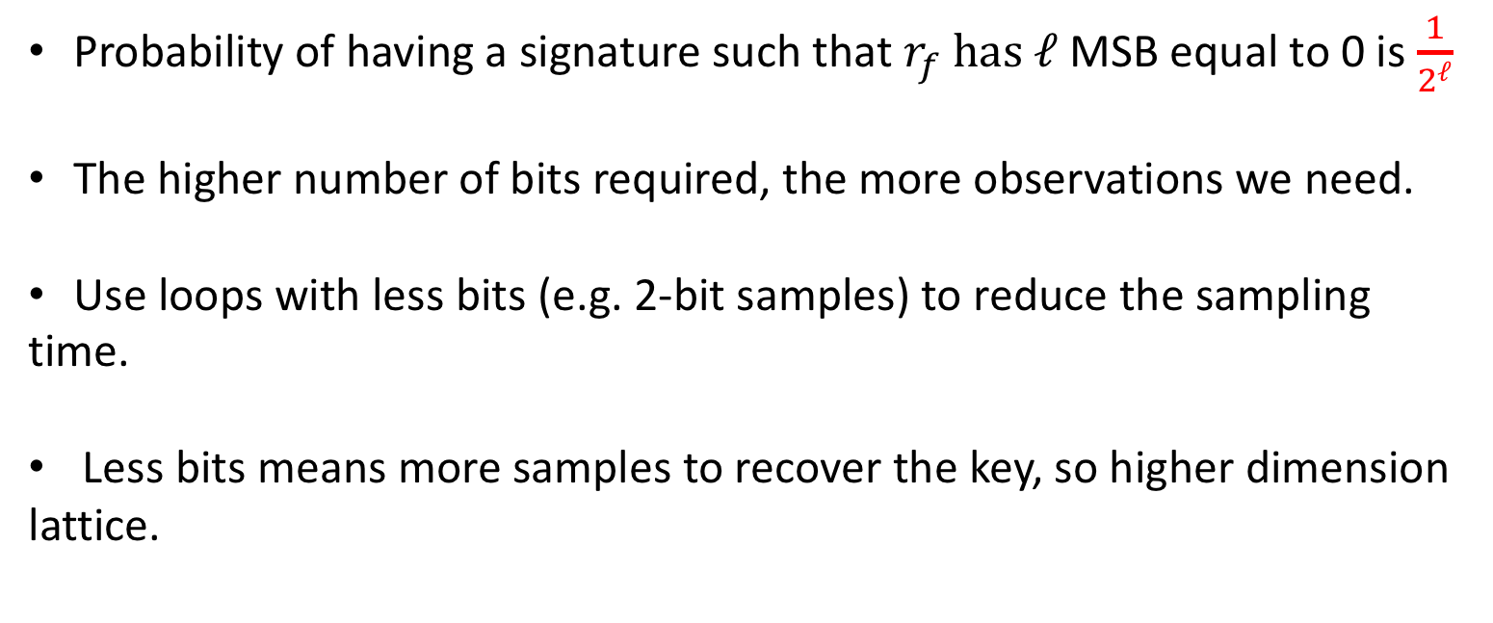
Samples of different lengths
Performance tradeoff: decrease the signature sampling time vs increasing time spent running lattice basis reduction.
Probability of having a signature such that $r_{f} has$ $ℓ$ MSB equal to 0 is $\frac{1}{2^{ℓ}}$
The higher number of bits required, the more observations we need.
Use loops with less bits (e.g. 2-bit samples) to reduce the sampling
time.
Less bits means more samples to recover the key, so higher dimension
lattice.
Notes:
The obvious question here is "why not just use all 2-bit samples?". Mention that it would be a very high dimensional lattice.

Slide 40
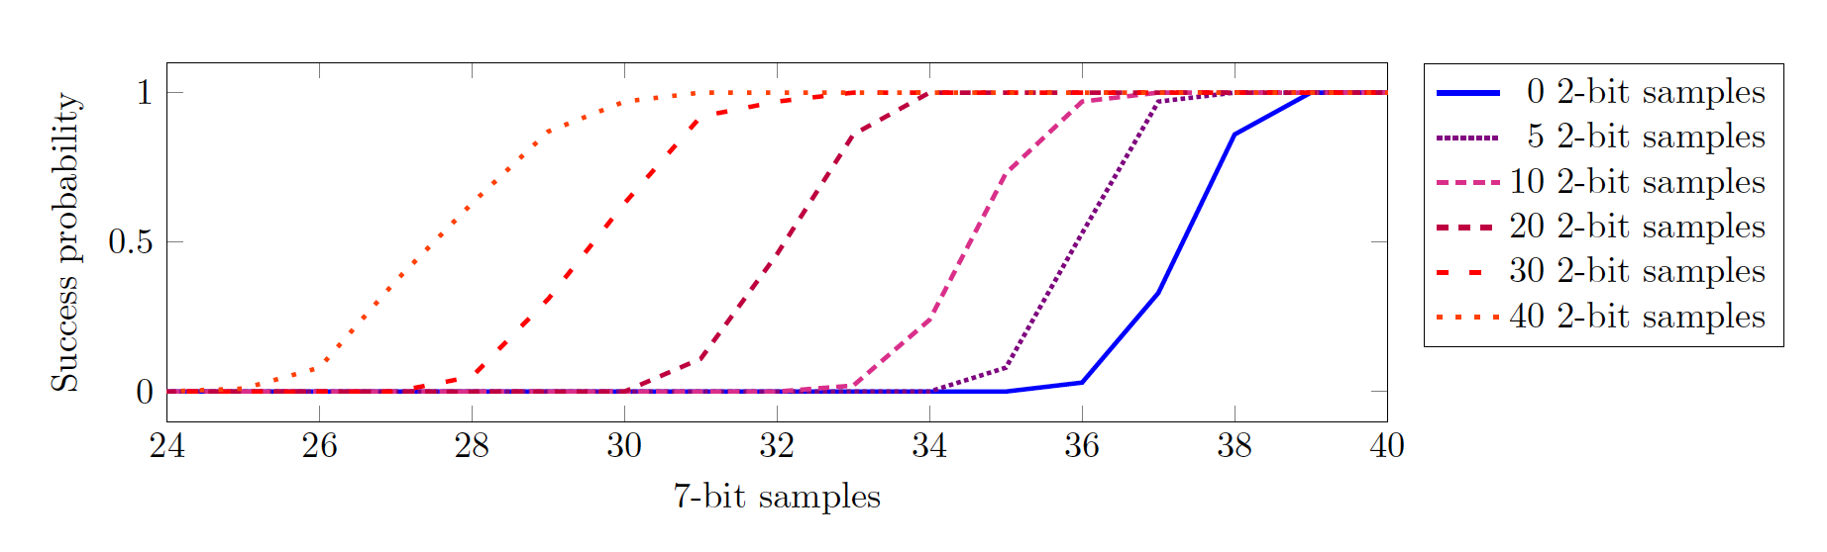
Example
Using only 49-loop samples in the lattice, i.e. learning 7 most significant
bits of the nonce, we need 38 samples to achieve above a 50% success rate in the
lattice construction (blue line).
We can reduce the total number of samples we need to collect by including
samples that had revealed 2 bits of the nonce.

Slide 41
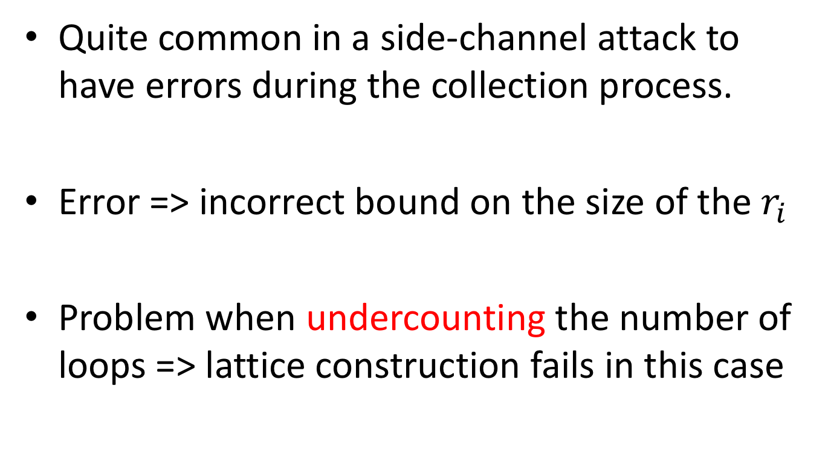
Error correction
Quite common in a side-channel attack to have errors during the collection process.
Error => incorrect bound on the size of the $r_{i}$
Problem when undercounting the number of loops => lattice construction fails in this case

Slide 42
Prior work
Ignore the issue entirely
Use signal processing
Subsample different subsets of samples until we get an error-free sample

Slide 43
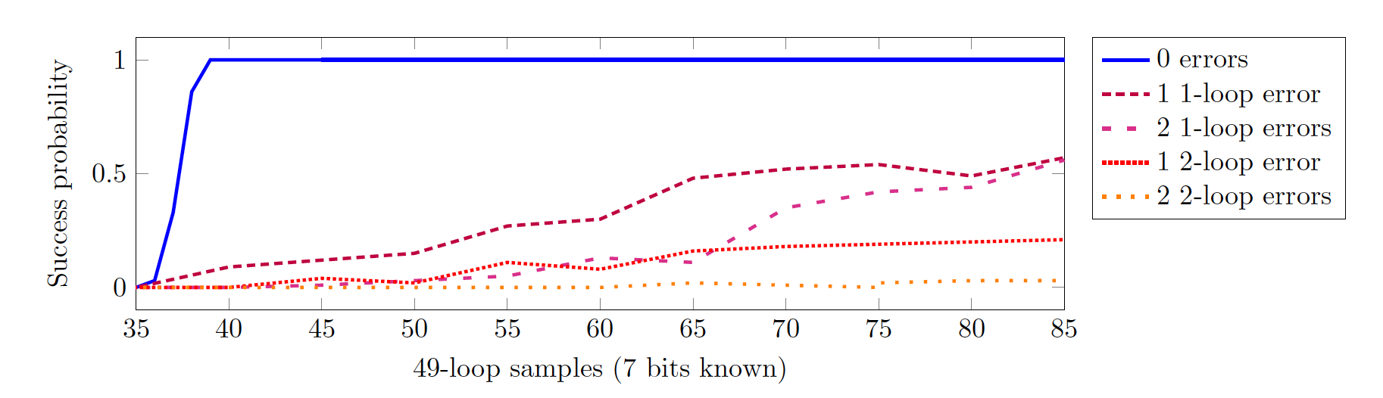
Error analysis
When the lattice includes more samples than necessary, key recovery may still be possible in the presence of errors.
In our measurements, an error corresponds to an incorrect loop count.

Slide 44

Recovering f
10 600 signatures required if only using 49-loop samples to get 37 error-free samples.
Use samples of different loop lengths
Reduce the number of signatures with manual inspection: less than 7 500 observed
signatures to obtain enough 49-loop observations for a full key recovery.

Slide 45
Conclusion
We finally have f.
Limitations: we can’t run the attack ourselves as all the EPID signatures are encrypted with Intel’s public key !
A malicious Intel could break the unlinkability guarantee.

Slide 46
Thank you !
CacheQuote: Efficiently Recovering Long-term Secrets of SGX EPID via Cache Attacks
Fergus Dall, Gabrielle De Micheli, Thomas Eisenbarth, Daniel Genkin, Nadia Heninger, Ahmad Moghimi, and Yuval Yarom

